Slide 1

The Tragedy Of Flight: A Comprehensive Crash Analysis

Slide 2
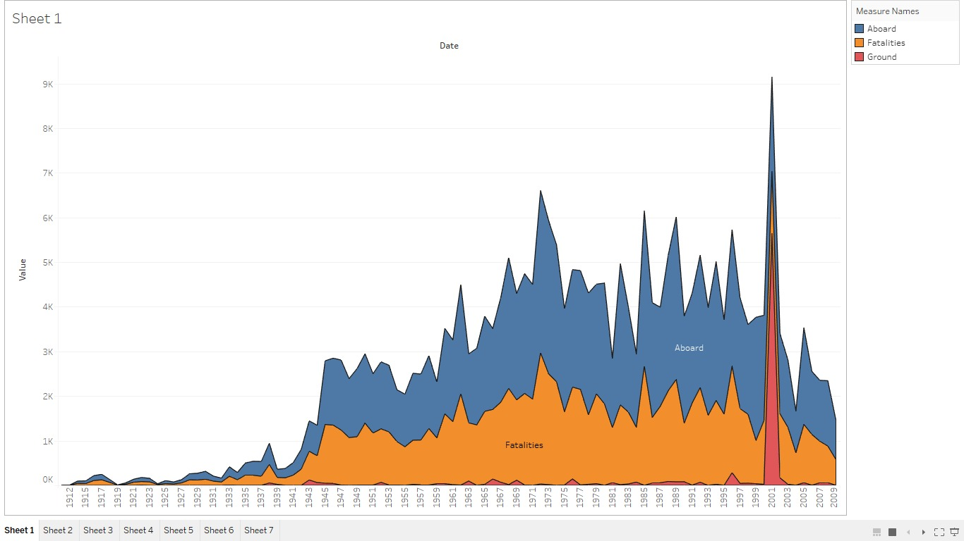
Comparing Abroad vs Fatalities vs Ground

Slide 3
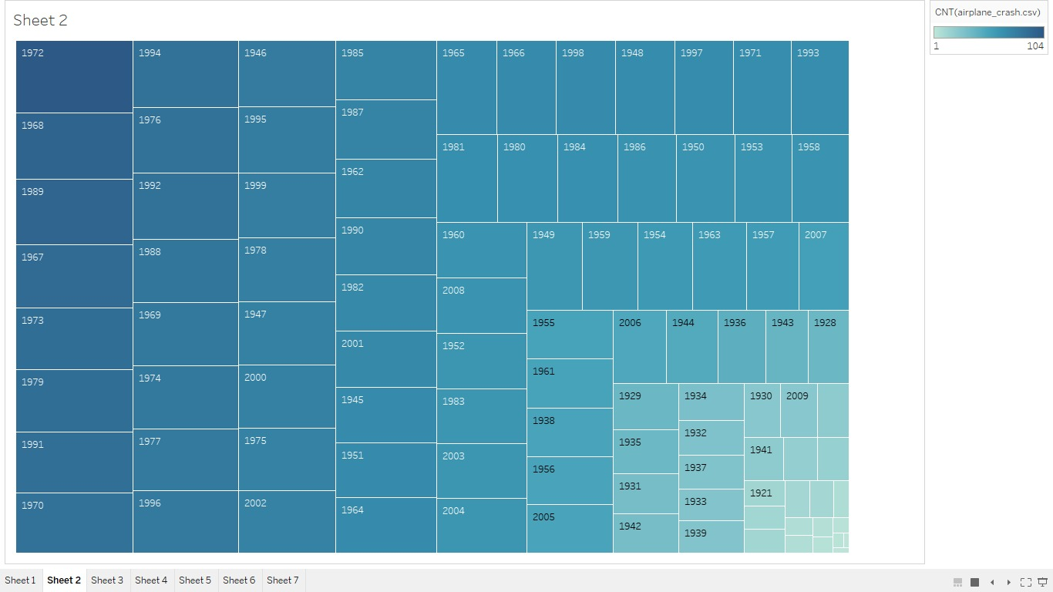
Max accidents based on years

Slide 4
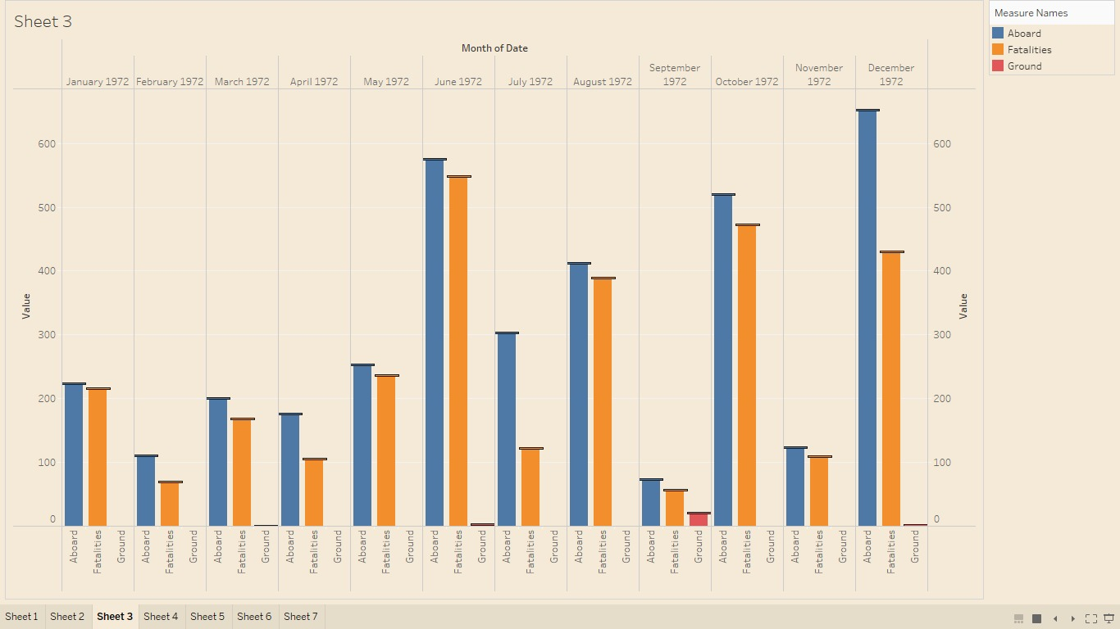
Accidents happened in 1972 based on months

Slide 5
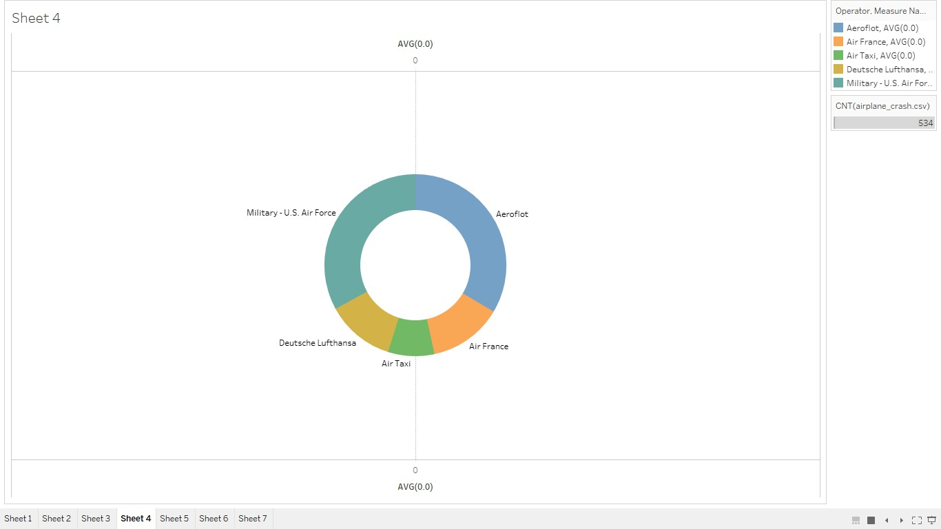
Highest No.of accidents happend by operators

Slide 6
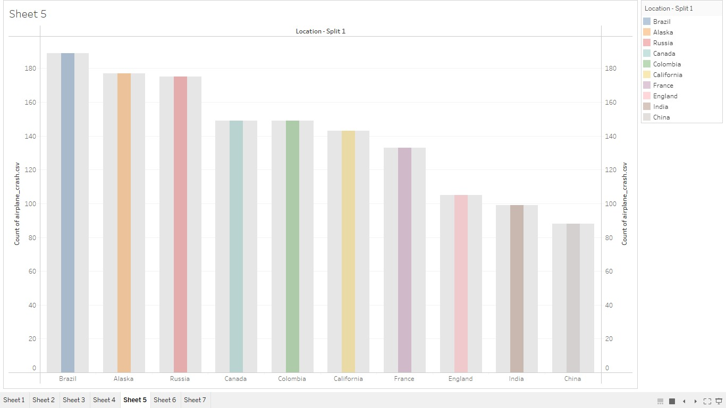
Top 10 locations which had more accidents

Slide 7
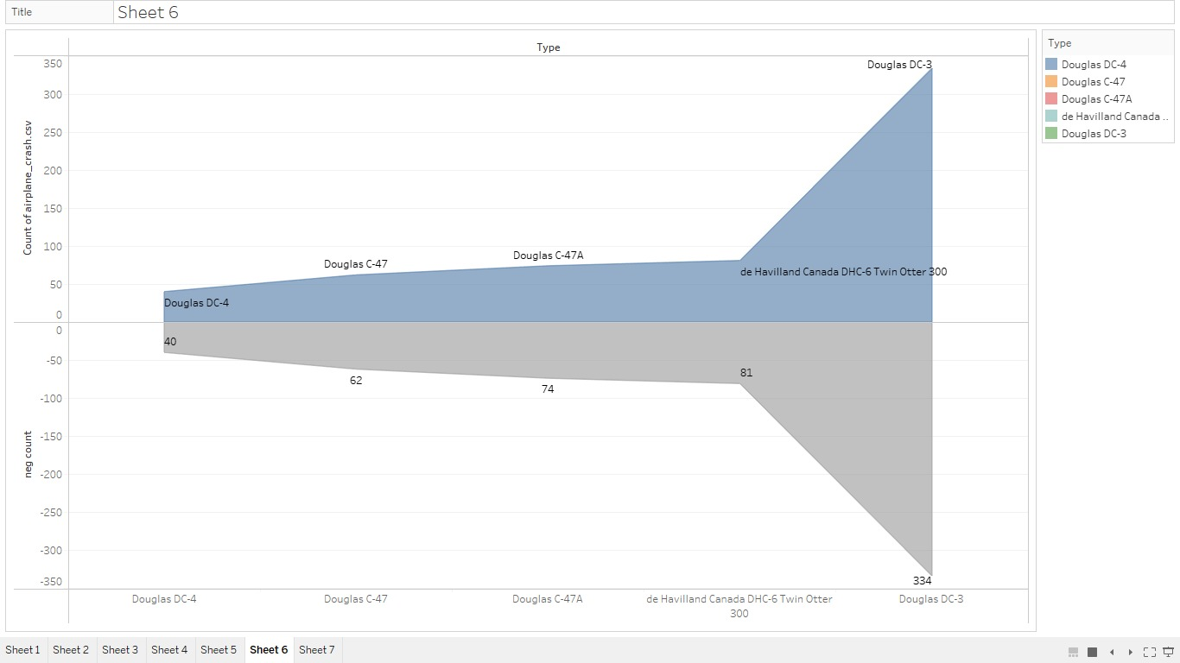
Top 3 flights which have max accidents history

Slide 8
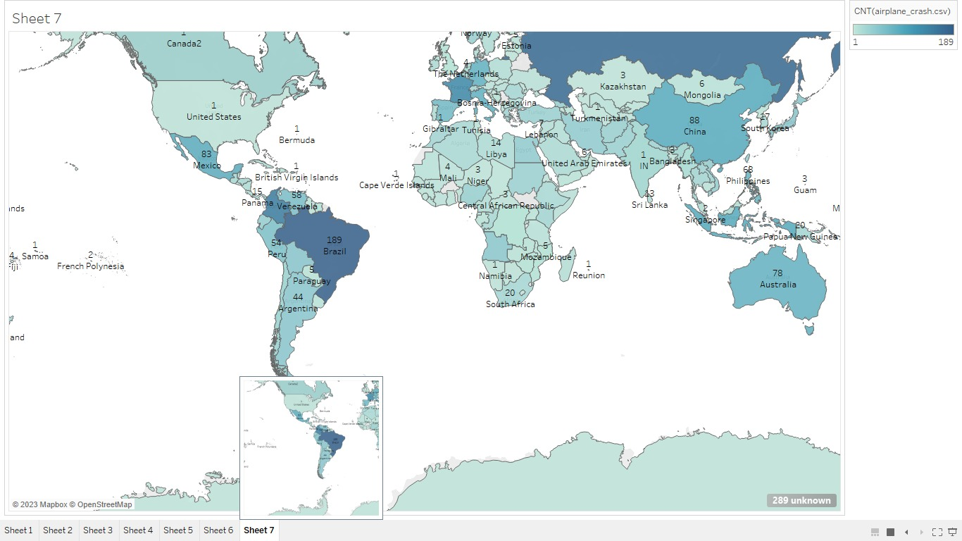
Accidents based on regions

Slide 9
Thank You

